Slide 1
Priority Exchange
An algorithm to properly serve Aperiodic Tasks.
Akinwande Mofifoluwa Ipadeola
SS2025, Real-Time Systems

Slide 2
MOTIVATION
In a real-time system scenario, what happens when an aperiodic request is made and an aperiodic task becomes avaialble?
Typical solutions lead to long wait and response times until these tasks get serviced.
Priority exchange algorithm was proposed in order to reduce the wait and response times of these tasks while maintaning the strict deadlines required for periodic tasks.

Slide 3
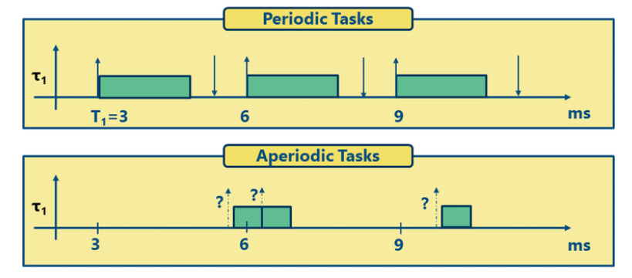
Periodic vs. Aperiodic Tasks
(1)

Slide 4
Periodic & Aperiodic Tasks
Two main approaches for scheduling periodic tasks are:
Earliest Deadline First (EDF)
Rate Monotonic Scheduling (RMS)
Common methods for handling aperiodic tasks include:
Polling Server – A periodic task (the server) is created specifically to check for and serve aperiodic requests at regular intervals.
Background Servicing – Aperiodic tasks are only executed when the CPU is idle and no periodic tasks are ready to run.
What is the issue with servicing Aperioidic Tasks this way?

Slide 5
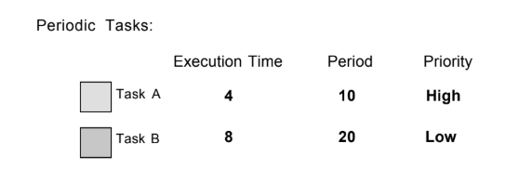
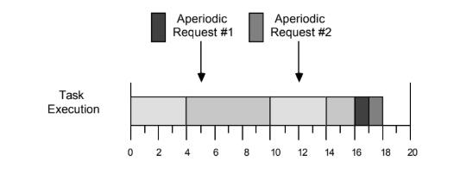
The Aperiodic servicing Problem
Background servicing
[2]
[2]

Slide 6
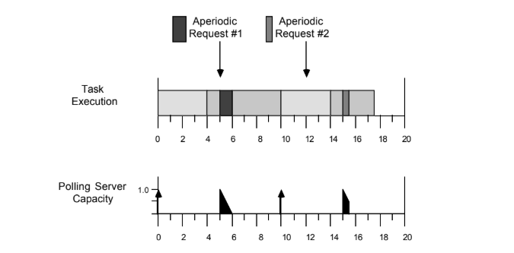
The Aperiodic servicing Problem
Polling server
[2]
Problem: Long wait and response times for Aperiodic tasks.

Slide 7
Priority Exchange Algorithm
Proposed by Lehoczky, Sha, and Strosnider.
Designed to reduce the wait and response times for aperiodic tasks.
A high-priority periodic task, the Priority exchange server, is created to handle aperiodic requests.
If no requests arrives during the server‘s period, the server:
Exchanges its higher priority execution time with the next available periodic task.
Gains „credit“ at the priority level of that periodic task.
Unlike the polling server method, the PE server always reserves time to serve aperiodic tasks.

Slide 8

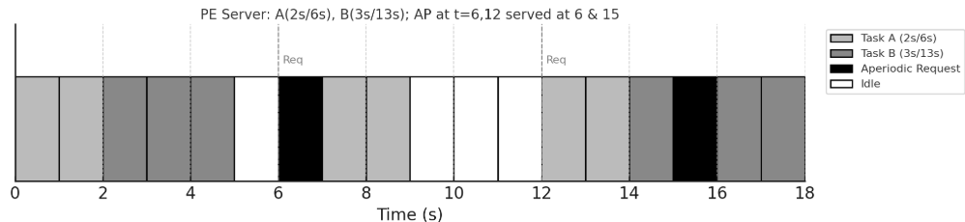
Priority Exchange Algorithm

Slide 9
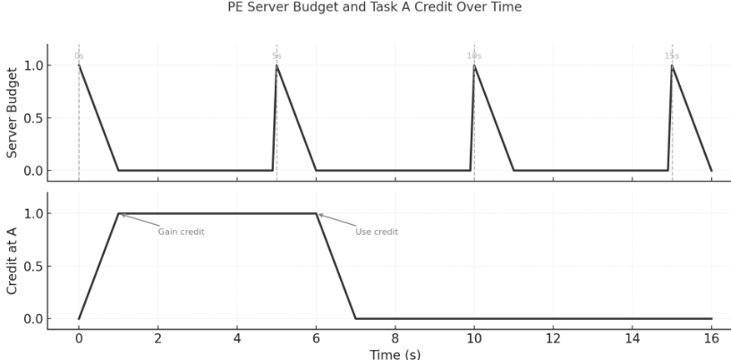
Priority Exchange Algorithm

Slide 10
SUMMARY
Real time systems should always meet their strict deadlines
PE algorithm adds a high-priority server that “lends” unused budget to periodic tasks and stores equivalent credit at lower priorities.
Creates an avenue to effectively serve aperiodic tasks while keeping the stricter deadlines of periodic tasks.
Compatible with RMS so worst case timing analysis can be done.

Slide 11
References
Software development of reconfigurable real-time systems - Scientific Figure on ResearchGate. Available from: https://www.researchgate.net/figure/Periodic-Aperiodic-Sporadic-Task-Characteristics_fig5_354494360 [accessed 4 Jun 2025]
[2] B. Sprunt, “Aperiodic task scheduling for real-time systems,” Ph.D.dissertation, Carnegie Mellon University, 1990.

